Slide 1
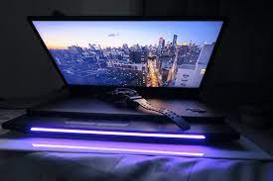
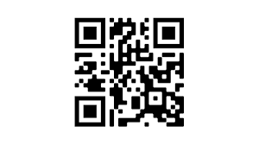
SCAN ANSWERSHEET
GROUP 3 - PROBLEM 8th
TEAM BOUNTY HACKERS
HACKATHON 2023
GNDEC , LUDHIANA

Slide 2
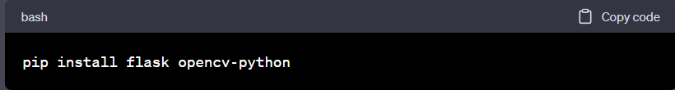
Setup Python Environment
First We Built Python Environment so that we could build the solution easily in a structured manner . The Pragramming Language Used is Python and Code Editor is Visual Studio Code . Web Framework is Flask . As Flask is Lightweight and easy to work-on.

Slide 3

Python Modules Used in the Development :
PIL (Python Image Library)
PyTesseract (Used for Optical Character Recognition)
CV2 (Used to display an Image in Window)
Flask (Framework)

Slide 4
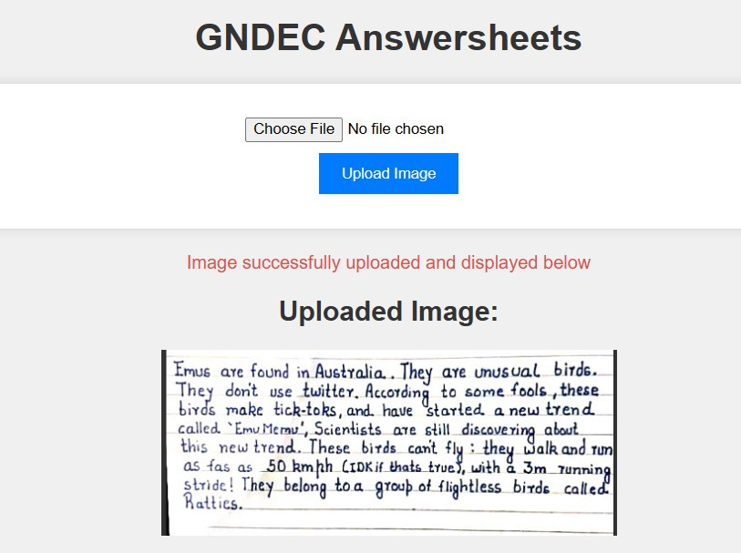
IMPLEMENTATION :
ANSWER SHEET UPLOAD :

Slide 5
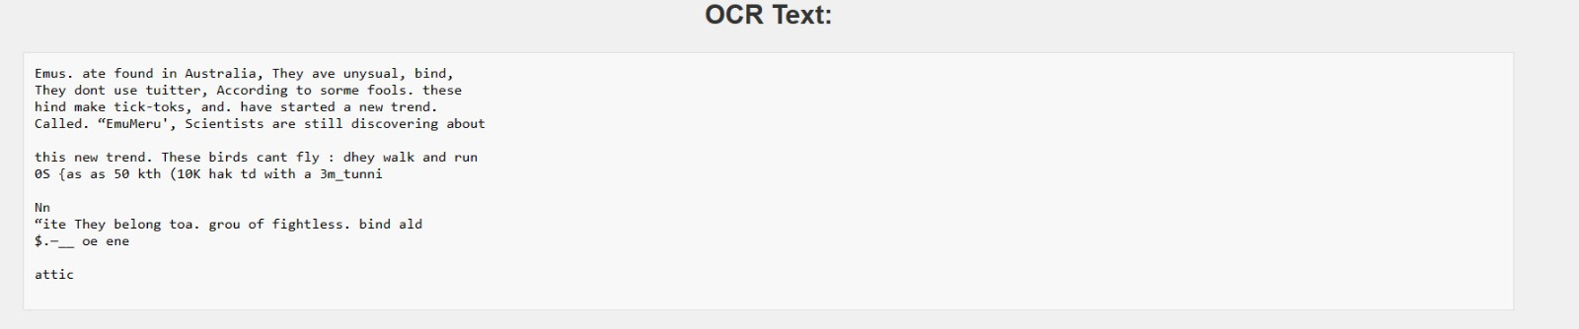
Text from Image Generated Using OCR
OCR TEXT :
Text Accuracy is around 92% but we can increase it more with constant efforts

Slide 6
That’s It for Now !

